Slide 1
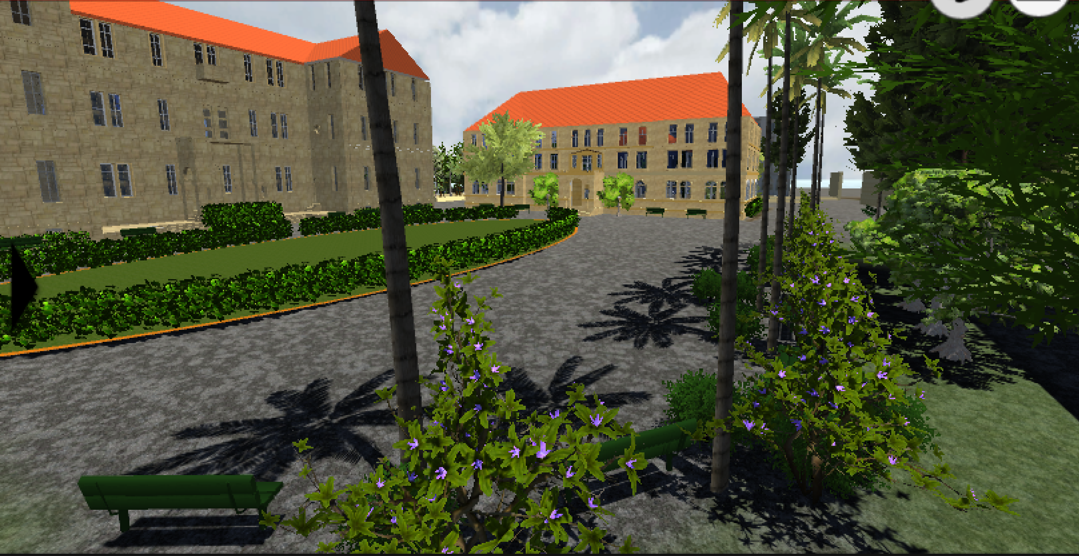
AUB Kiosk
Team Members: Sarah Fakhoury,
Samer El Masri, Ines Badji.
Mentor: Dr. A. Dhaini

Slide 2
Introduction
Software: Unity 3D, Sketchup, Blender
Kiosks around campus.
3D map of AUB’s campus (with realistic rendering of all buildings).
Main Parts: On and Off Campus.

Slide 3
How The Buildings are Made?

